Slide 1
Development of master curricula for natural disasters risk management in Western Balkan countries
How to improve quality of promotions of trainings (LLL courses) and students enrolment – EU experience
University of Messina, Sicily Italy
Fifth Quality Assurance Committee meeting/ 20th March 2019
Project number: 573806-EPP-1-2016-1-RS-EPPKA2-CBHE-JP
"This project has been funded with support from the European Commission. This publication reflects the views only of the author, and the Commission cannot be held responsible for any use which may be made of the information contained therein"

Slide 2
C.O.P. CENTRO ORIENTAMENTO E PLACEMENT SERVICES
Development of master curricula for natural disasters risk management in Western Balkan countries
The Center helps students to choose university courses, supports them during their university career, and facilitates their entrance into the labor market.
The services offered by the C.O.P. are organized into the fields listed below:
Guidance for future students;
Guidance for enrolled students and mentoring programmes;
Guidance for graduated students & Career Services;
Networking and Agreements with Public and Private Companies;
Platform “Almalaurea”, services for increasing employment for graduates.

Slide 3
Choosing means to consciously build one's way
Development of master curricula for natural disasters risk management in Western Balkan countries

Slide 4
Orientation for future students and for enrolled students: what we do for our students?
Development of master curricula for natural disasters risk management in Western Balkan countries
We help future students to choose their course of study:
Information about university courses;
Individual interviews and specific guidance tests;
Participation to most relevant career guidance fairs and networking events at local and national level;
We offer Counseling and Coaching services:
1st step: Interviews by our guidance counselors;
2nd step: Submission of tests like Holland Test, Big Five Test or a specific platform called “SOR.PREN.DO”.

Slide 5
HOLLAND TEST
Development of master curricula for natural disasters risk management in Western Balkan countries
Holland Codes are among the most popular models used for career tests today. Holland argued that the choice of a vocation is an expression of personality. There are six personality types in Holland's model and most people will fit into a few of the categories:
Realistic, Investigative, Artistic, Social, Enterprising, Conventional.

Slide 6
Services for students
Development of master curricula for natural disasters risk management in Western Balkan countries
This test is a very useful guidance tool. It allows interests and abilities matching in order to choose the right way for employability.

Slide 7
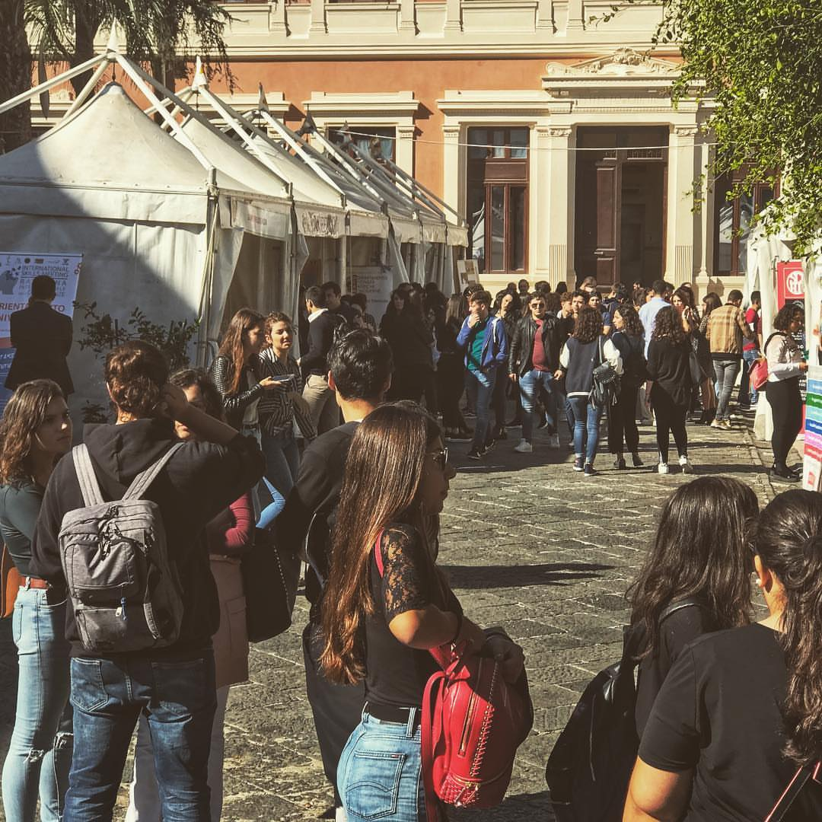
Guidance Events with Secondary Schools
Development of master curricula for natural disasters risk management in Western Balkan countries
Future students orientation aims at helping high school students in their choice and promoting the image of University of Messina and its courses.

Slide 8
Student training periods in companies
Development of master curricula for natural disasters risk management in Western Balkan countries
Our University offers specific training periods to students attending different degree courses in all academic fields: Sciences, Social Sciences, Engineering, Veterinary medicine, and so on.
We promote internships for post graduates, in Italy and abroad .

Slide 9
Guidance Laboratory
Development of master curricula for natural disasters risk management in Western Balkan countries
The COP organizes many guidance laboratories open to students or to graduates who are looking for a job.
Laboratories aim at strengthening:
Learning methods and soft skills;
Scientific knowledge and linguistic skills to access university courses with restricted access;
Employability Laboratory like how to write a CV and a letter of presentation, how to manage an job interview, etc.

Slide 10
Development of master curricula for natural disasters risk management in Western Balkan countries
Orientation summer school held every year for future students who have the opportunity to know directly university locations, labs and academic units with the aim to learn about social and academic resources/programs, to receive academic suggestions, to meet new people and make connections, to have fun.
Courses aim at:
1. Guidance and strategies for Learning methods;
2.Strengthening of Scientific and Linguistic skills.

Slide 11
Placement and Career Services
Development of master curricula for natural disasters risk management in Western Balkan countries
Supporting enterprises in finding “the right person at the right place”.
Matching demand/offer of labour market:
We manage CV and we organize Business presentation where graduates meet enterprises;
Promoting Employability:
We promotes internships in Italy and abroad and apprenticeship contracts (more than 70 only in 2015-2018).

Slide 12
Partnerships
Development of master curricula for natural disasters risk management in Western Balkan countries
The COP has subscribed more than 800 framework agreements with private and public companies for enrolled students to make internships in Italy and abroad;
Specific agreements with companies and Public Bodies are subscribed for graduates to ease their access to the labour market

Slide 13
Development of master curricula for natural disasters risk management in Western Balkan countries

